Slide 1
Creating a Good Post for r/datascience

Slide 2
Collecting Data
Tried an assortment of techniques
Data was collected using Python Reddit API Wrapper.
Collected almost 1000 posts sorted by top and another 1000 sorted by new

Slide 3
The Problem
What words have the greatest impact when creating a successful post on the data science subreddit?
Success is defined here as having comments and score above the 50th percentile. This is equivalent to receiving 15 or more comments and having a score of 55 or higher.

Slide 4
Modeling
Count vectorization with random forest and logistic regression
Term frequency – inverse document frequency with random forest and logistic regression
Ultimately decided on count vectorization and logistic regression
Received an accuracy score of 0.58 which is 8% above the baseline.

Slide 5
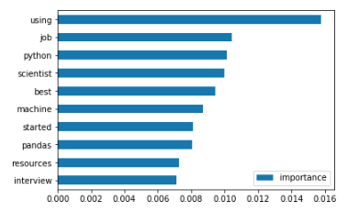
Random Forest Features

Slide 6
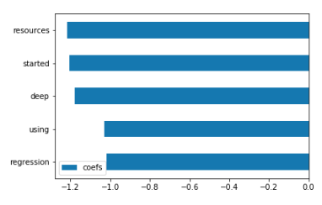
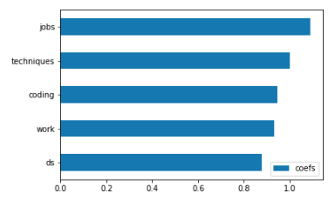
Logistic Regression Features

Slide 7
Conclusion
This subreddit appears to be not as friendly to beginners
The words “started” and “resources” appear to negatively impact a post’s chances of success.
This subreddit prefers practical examples or career oriented questions.
This is evidenced by the words “jobs” and “work” having a high impact on success.

Slide 8
Further Research
Collect a greater assortment of posts not sorted by top.
The data was heavily skewed as a result of 50 posts that had extremely high scores and comments.
These posts may have reached r/all and have uncharacteristically high scores and comments
Try Naïve Bayes as opposed to Logistic Regression
GridSearch

